Slide 1
A STUDY ON REAL LIFE APPLICATION OF DATA ENVELOPMENT ANALYSIS
G.Ashwin 2014B4TS960P
Apurva Mittal 2014B4A7658P
Aayushi Agrawal 2014B4A3809P

Slide 2
Data Envelopment Analysis
It is a linear programming technique that measures the efficiency of various decision making units(DMU’s) when the production process has a structure consisting of several inputs and outputs
It is a non-parametric methodology
Charnes, Cooper and Rhodes came up with the name Data Envelopment Analysis in 1978
Notes:
No assumptions are made about the form of the production technology or the production function
and proposed an input orientation with Constant Returns to Scale(CRS)
- The technique is named so as the aim is to build a frontier that envelops the input-output vectors.

Slide 3
Efficiency Measures
Before the origin of CRS and VRS models, Farrell suggested a linear convex hull approach to estimate frontiers
Two components regarding efficiency of a firm put forth by Farrell :-
Technical efficiency
Allocative efficiency
Notes:
Ability of a firm to obtain maximal output from given set of inputs
Ability of a firm to use inputs optimally, given their respective prices

Slide 4
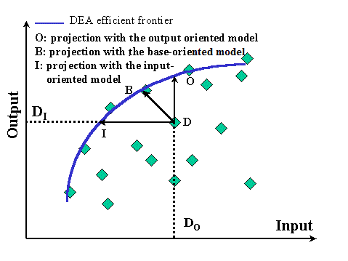
Input and Output Oriented Measures
Input oriented model
Output oriented model
Figure-Difference between Input
and output oriented models
Notes:
looks at the amount by which the inputs can be reduced, given fixed outputs
looks at how outputs can be increased, given fixed inputs

Slide 5
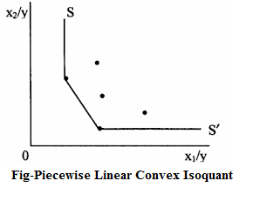
CRS Model
What is the aim of the CRS model?
Notes:
The aim of the problem is to take the i^{th} firm and radially contract the input vector, denoted by x_{i} , as much as possible
The boundary is a piecewise linear isoquant which will be determined by the observed points

Slide 6
CRS Model
We shall assume that the data is on K inputs and M outputs on each of N DMU’s
Notation: K inputs, M outputs, N firms
x_{i} is K×1 vector of inputs of i-th firm
y_{i} is M×1 vector of outputs of i-th firm
X is a K×N input matrix, Y is a M×N output matrix
μ = M×1 vector of output weights
ν = K×1 vector of input weights
θ is a scalar (=TE), λ is a N×1 vector of constants

Slide 7
CRS Model
A mathematical programming problem is specified
This form is called the multiplier form of the linear programming problem

Slide 8
CRS Model
Using duality we develop an equivalent envelopment model of this problem
The value of θ that we obtain is the TE
The linear programming problem should be solved N times
Notes:
of the i-th firm it satisfies : θ ≤ 1, where a value of 1 indicates a point on the frontier and hence a technically efficient firm.
The linear programming problem should be solved N times, once for each firm in the sample. A value of θ is then obtained for each firm.

Slide 9
Why Dual?
Lesser number of constraints as number of DMUs is considerably larger than total number of inputs and outputs.
We cannot find the pertinent max-slack solution by solving primal CRS model.
The interpretations of Dual CRS model are more straightforward.

Slide 10
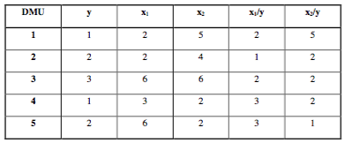
Example 1
Data of 5 DMUs to produce single output from 2 inputs.

Slide 11
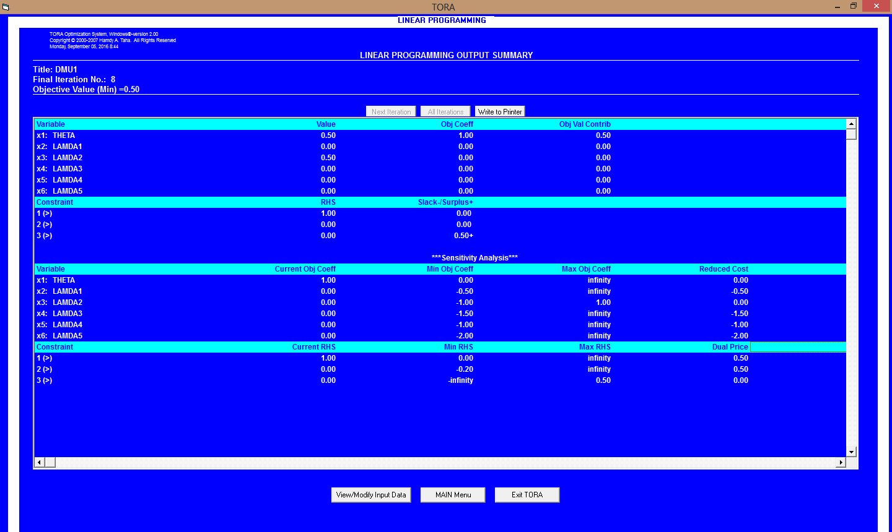
TORA

Slide 12
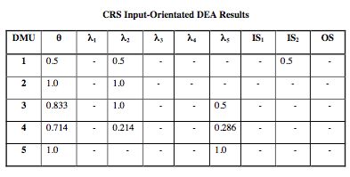
Results

Slide 13
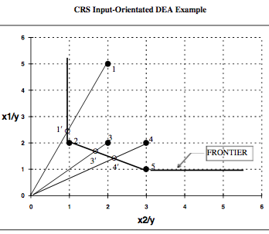

Slide 14
VRS
CRS LPP is converted to VRS by addition of a convexity constraint.
where N1 is a N x 1 vector of ones.
This constraint characterizes increasing, decreasing and constant returns to scale.

Slide 15
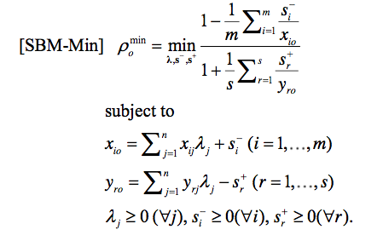
SBM
Slack Based Measure is units invariant and monotonically decreasing w.r.t. output and input slacks.

Slide 16
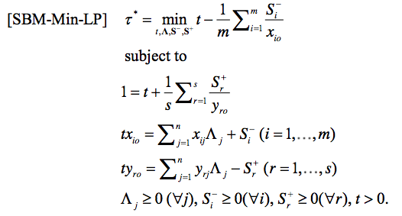
SBM
The corresponding LPP is :
DMU is SBM efficient iff it is CCR efficient.

Slide 17
DEA APPLICATION
Selection of DMUs:
Homogeneity
Number of DMU’s
Inputs
Academic staff
Sanctioned Money
Outputs
Total Students
Progress
Awards

Slide 18
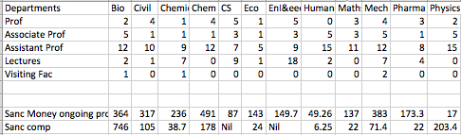
PILANI INPUTS

Slide 19
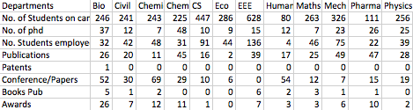
PILANI OUTPUTS

Slide 20
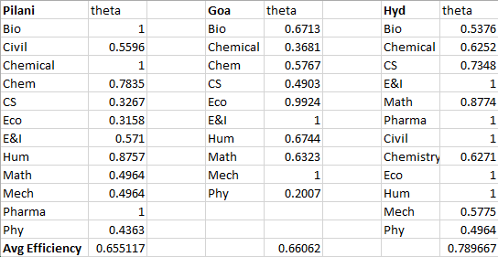
EFFICIENCIES

Slide 21
BANKING
Inputs
Total capital share
Total shareholders funds
Assets, Net Non profit Assets
Net worth(consolidated)
Operating Expenses
Employees cost
Capital and Liabilities

Slide 22
OUTPUTS
Net profit/loss
Net increase/decrease in cash and cash equivalents
Income from investments
Interest on balance with RBI and other inter bank funds
Interest/Discount on advances/ bills

Slide 23
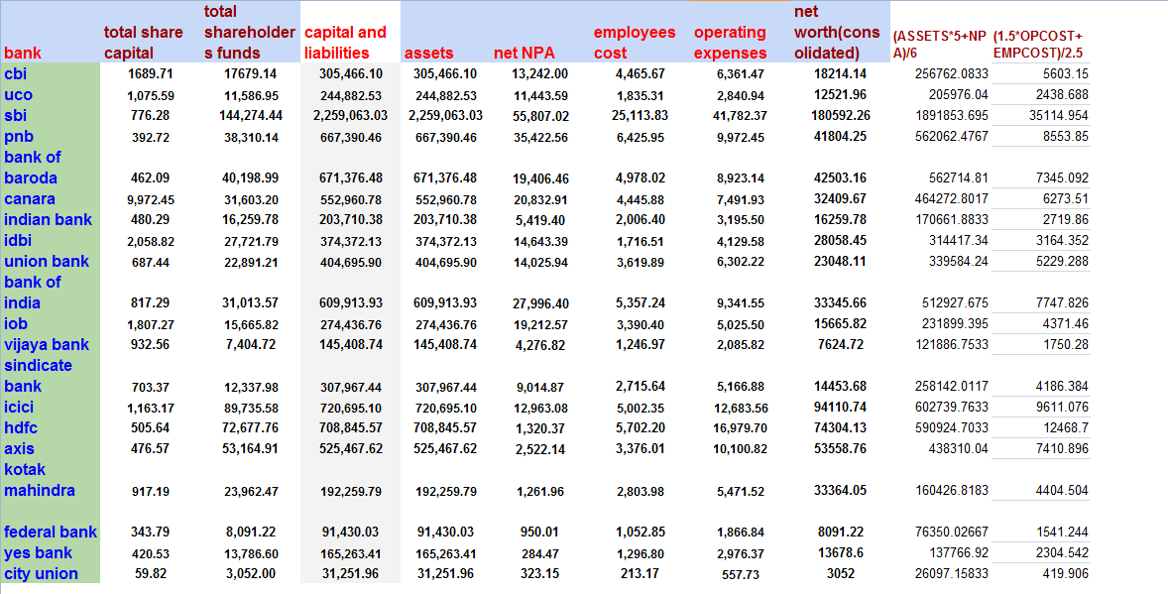
BANK INPUTS

Slide 24
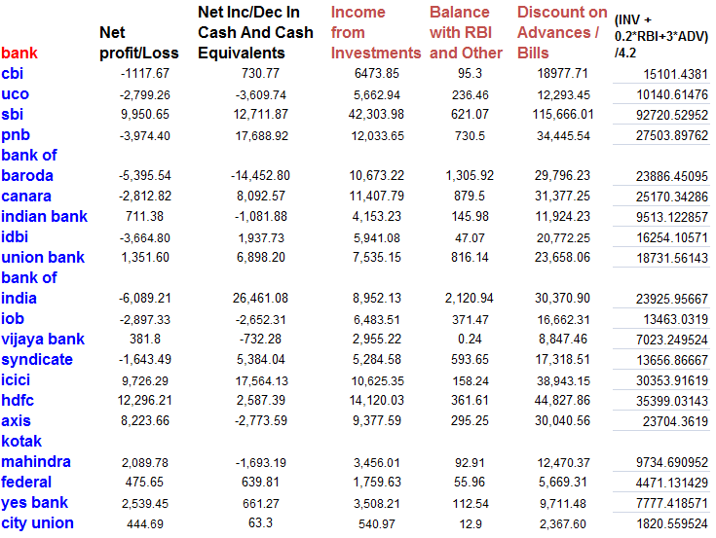
BANK OUTPUTS

Slide 25
EFFICIENCIES
Bank | Efficiency
CBI | 0.8066
UCO | 1.0000
SBI | 1.0000
PNB | 1.0000
Bank of Baroda | 1.0000
Canara | 0.9578
Indian bank | 0.9104
IDBI | 0.8617
Union bank | 1.0000
Bank of India | 1.0000
bank | efficiency
IOB | 0.9629
Vijay bank | 1.0000
Syndicate bank | 1.0000
ICICI | 0.7496
HDFC | 0.9584
Axis | 0.9661
Kotak Mahindra | 0.4637
Federal | 0.7280
YES | 0.9464
City union | 1.0000

Slide 26
COST INCURRED
Free!

Slide 27
REFERENCES
Banker R.D., Charnes A., Cooper W.W. (1984), “Some Models for Estimating Technical and Scale Inefficiencies in Data Envelopment Analysis”, Management Science 30(9), pp 1078 – 1092
Charnes A., Cooper W.W. and Rhodes E.(1978), “Measuring the efficiency of decision making units”, European Journal of Operation Research, 2(6), pp 429 – 444
Farrell Michael (1957), “The Measurement of Productive Efficiency”, Journal of Royal Statistical Society, 120(3), pp 253 – 290
Tone K. (2001), “A slack-based measure of efficiency in data envelopment analysis”, European journal of Operation Research, 130(3), pp 498 – 509
William W. Cooper1, Lawrence M. Seiford2 and Joe Zhu3 (2011),”Data Envelopment Analysis: History, Models and Interpretations”, Austin, Springer

Slide 28
Thank You

